Slide 1
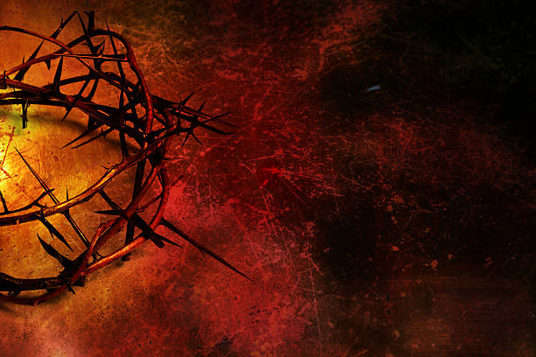

Apr 3/23: edits on 49 (ereb to arab); 52 [remove underline]; 70,86,89 – change cross to tree; #46: changed some white font to black – it was missed originally. CF made new files for the DVD as well. Not printing #95 for PDF.
The
Crucifixion
According To John
A Study on
the Timing of
Yahusha’s Death
Notes:
Sent to Neil for video jpeg apr 18/21 vj 1.15 Crucifixion According to John
Apr 3/23: Tim taught for 2023 Passover – added 2 new slides; CF did some minor edits. Made new files for season 1.

Slide 2

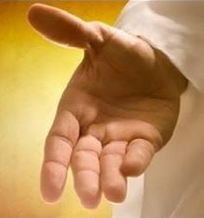
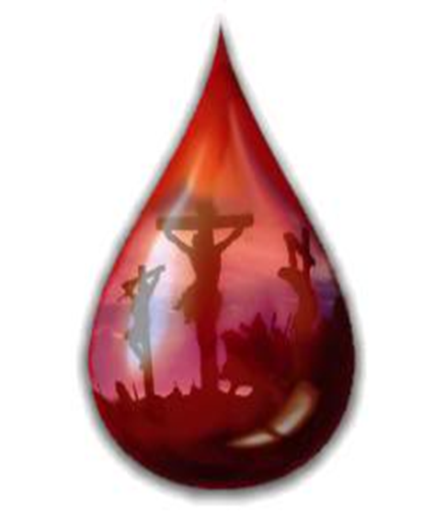
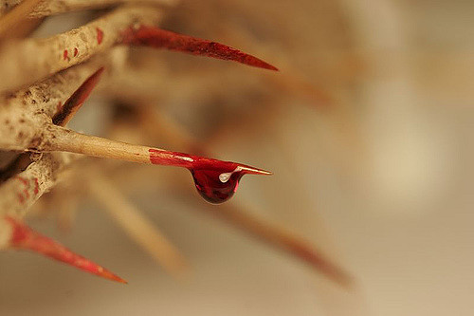
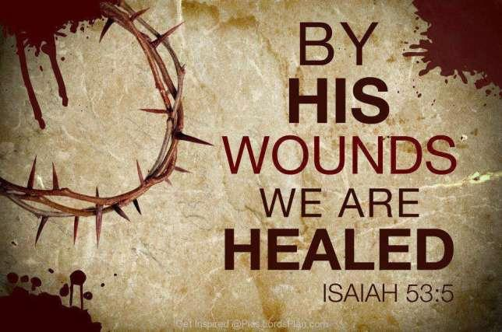
Yahusha Ha Mashiach Ratifies the
Melchi-Tzedek Covenant for You
Through
His
Blood
Will you accept?
Through His Blood.

Slide 3
The
Crucifixion
According To John
The
Crucifixion
According To John
The explicit purpose of this writing is to first ascertain the actual dates for the pre-crucifixion activities and events that occurred on Passover.
Next, is to find upon what date and what exact time of the 24 hour cycle, these horrific events of the crucifixion transpired.

Slide 4
All Scripture verses will be taken from The Scriptures edition unless otherwise noted.
This study incorporates the Qodesh (Holy) Hebrew Names.
We are going to pick up the story starting in John 13.
John 13:1 And before the Festival of the Passover, יהושע [Yahusha] knowing that His hour had come that He should move out of this world unto the Father, having loved His own who were in the world, He loved them to the end.
Inspired Scripture claims Passover is on Abib 14. Verse #1 takes place on Abib 13!
John 13:2 And supper taking place, the devil having already put it into the heart of Yehuḏah from Qerioth, son of Shimʽon, to deliver Him up,

Slide 5
Supper has ended. Supper is at the end of a Light Season, or end of the “day.” The Passover Seder meal always started in the Night Season (Exodus 12:8 gives instructions to eat the meal at night - <layil>, H3915). Therefore because Yahusha was still very much alive at this time we know for certain that this definitely was NOT the Passover Seder. It was His last earthly supper with the disciples,
prior to His death (John 13:1,2). Yahusha was utilizing it to introduce His Apostles to the very rituals that were to replace the physical sacrifices and oblations that were to take place on the following cycle of Abib 14.
Abib 14 was – the 4th cycle of the week – (Wednesday in pagan terms).

Slide 6
It was presently the 3rd cycle (Tuesday) Abib 13 Night Season.
For Scriptural support for Passover on Abib 14, see:
(Ex 12:6/Lev 23:5/Num 9:5; 28:16/Josh 5:10/2 Chron 35:1)
It cannot be the 12th of Abib because, as recorded by John, when the following Dawn occurred the Preparation (for the 1st Unleavened Bread Sabbath) — or the 14th day of Abib — had begun. John recorded the events much the same as a live broadcast on TV.
The events are written down just as they occurred.
Step by step John leads his readers through the different scenarios that are all interconnected.

Slide 7
“Reporter John” did not give any indication of Abib 14th Passover/Preparation Day arriving before, at, or after SUNSET, nor after darkness. Three visible stars were/are the Jewish traditional requirement for a “new day at night (?)” to begin (according to Sunset Theory).
There is no mention of a new cycle nor reference to the stars.
Therefore as an Inspired reporter of Yahuah, had the cycle of the week actually changed at the sunset, John would have missed a GOLDEN OPPORTUNITY to announce the Preparation/Passover Day had commenced in a perfect succession of events!
However, John did no such thing.
WHY? Did John “BLOW IT” as a reporter?

Slide 8
In this series of Dawn studies we have found that every cycle before a Sabbath of any kind, on any cycle of the week, is a Preparation cycle. This has become very clear (John 19:31). The Scriptural facts destroy our traditional mindset of believing that a Preparation cycle MUST ALWAYS OCCUR on a 6th cycle (Friday).
With the cycle of Passover being ultra important, if the sunset had brought on the Passover cycle, then our reporter John, by not announcing it until John 19:14, would have made a VERY SERIOUS MISTAKE.
At this point it becomes easy to understand that the sunset failed to change the cycle of the week. Abib 13 started at Dawn and continued seamlessly through the sunset period without any date change whatsoever. Sunset Theory has failed on this date.

Slide 9
Reporter John’s NON-Proclamation of Time
1. The last meal of the day has ended somewhere in this time frame.
4. Was John oblivious to the idea that the sunset may have changed Abib 13
to 14 and therefore beginning the Passover Feast - at Sunset?
Sunset
Dawn
Abib 13 | Abib 13 | Abib 14
2. According to Sunset Theory, the sunset would bring Abib 14 with the Passover IMMEDIATELY next in line!
3. Yet John’s TOTAL SILENCE on announcing the beginning hours of the Passover speaks THUNDEROUS VOLUMES!

Slide 10

Upon which celestial event did John announce THE START of the
Passover Festival?
Sunset
or
Dawn
Abib 13 | Abib 13 | Abib 14

Slide 11
Question: What time of the 24 hour cycle was it leading up to now?
John 13:30 So, having received the piece of bread,
he [Judas] then went out straightaway, and it was night.
What time was it when Judas and company began their evil mission?
Night Season — the exact same “dated time period” as when Yahusha sat down for supper with His disciples! No cycle exchange - not yet!
The natural sequence of events outlining time thus far, according to Scripture, for >> Abib 13 are:
Dawn twilight, sunrise, morning, noon, through afternoon, sunset, evening twilight, darkness and now on into the dark hours before the betrayal in Gethsemane – AND STILL IT IS ABIB 13!

Slide 12
Yahusha gives a lot of instruction, advice and prayer between John 13:30 and John 18:1, where we learn they went into the Garden of Gethsemane.
The story picks up in verse 3.
John 18:3 Yehuḏah, then, having received the company of soldiers, and officers from the chief priests and Pharisees, came there with lanterns, and torches, and weapons.
Torches and lanterns were being utilized, because it was still night time.
It is still the same calendar date that BEGAN THE LAST SUPPER DURING THE DAYLIGHT SEASON - (see Matt 26:20).
Or – it was the same “24 hour dated cycle” that COMMENCED with Dawn. There is no documented transfer – YET – for an ultra-significant exchange such as Abib 13 switching to Abib 14 - The Preparation / Passover Day.

Slide 13
This is the same 24 hour cycle that John records as being – – John 13:1!
John 18:28 Then they led יהושע [Yahusha] from Qayapha to the palace, and it was early. And they themselves did not go into the palace, lest they should be defiled, but that they might eat the Passover.
BEFORE THE PASSOVER!
Next verse: The Jews did not want to defile themselves by entering the court of Pilate later on this same night, before the Passover.
The Jews knew full well the importance of timing. The problem is, they believed the Passover’s cycle importance was mostly the Seder meal!
Their observance of the Passover meal began at sunset, going into Abib 15!

Slide 14
It is the Night Season of the “capture in Gethsemane” and the Light Season is about to come on strong.
The Light Season following His “capture” was
the period of the Crucifixion.
So it is safe to declare this Night Season in Gethsemane
as Abib 13 according to –
Yahuah’s Covenant Calendar.

Slide 15
What time of the weekly cycle was it?
Luke 22:66 And when it became day, the elders of the people, both chief priests and scribes, came together and they led Him into their council, saying,
Dawn
After a very brief confrontation with Qayapha, we read -
Luke 23:1 And the entire assembly of them, having risen up,
led Him to Pilate …
This places Yahusha in front of Qayapha at Dawn, before sunrise!
Abib 13 Night Season | Abib 14 Light Season | Abib 14 Night Season

Slide 16
At this point, let’s have a brief look at an inherent problem directly associated with
Sunset Theory!

Slide 17
A Serious Sunset Theory Problem
The Pharisees were already observing times by Sunset Theory!
Luke 22:66 And when it became day, the elders of the people, both chief priests and scribes, came together and they led Him into their council ...
Dawn
What lamb’s flesh was eaten here?
Abib 14 Night Season | Abib 14 Light Season | Abib 15 Night Season
By Statute, the Passover meal was to be eaten Abib 14 Night Season, with the slain lamb’s flesh and unleavened bread. (Ex 12:6-8)
But wait! Yahusha was not slain by morning!
He was very much alive!
Ben Ha Arbayim (Between the Evenings) is [by Statute] when
the Passover Lamb was to be slain!

Slide 18
A Serious Sunset Theory Question!
What lamb’s flesh was eaten here?
Abib 14 Night Season | Abib 14 Light Season | Abib 15 Night Season
By Statute, the Passover meal was to be eaten Abib 14 Night Season, with the slain lamb’s flesh and unleavened bread. (Ex 12:6-8)
Yahusha was not slain by morning!
He was very much alive!
Ben Ha Arbayim (Between the Evenings) is [by Statute] when
the Passover Lamb was to be slain!

Slide 19
Ex 12:5 Let the lamb be a perfect one, a year old male.
Take it from the sheep or from the goats.
Ex 12:6 And you shall keep it until the fourteenth day of the same month. Then all the assembly of the congregation of Yisra’ĕl shall kill it between the evenings.
Ex 12:7 And they shall take some of the blood and put it on the two doorposts and on the lintel of the houses where they eat it.
Ex 12:8 And they shall eat the flesh on that night, roasted in fire – with unleavened bread and with bitter herbs
they shall eat it.
When (as in date?) and Where was Yahusha standing at Dawn awaiting His death sentence?
If Sunset Theory’s Abib 14 night had passed; with Yahusha standing before Pilate; (Luke 22:66) - WHY WAS HE STILL ALIVE??

Slide 20
Where was Yahusha STANDING
on this morning of Abib 14 –
according to Sunset Theory?
Was the body of The Lamb being properly disposed of (out of sight)
as per statute of Ex 12:10?

Slide 21
The last four slides give us a clear picture of Sunset Theory’s severe “misalignment-itis.”
☺

Slide 22
Another Perspective Altogether Different –
Let’s look at another consideration. The Passover in Egypt was
the type, therefore, Yahusha’s Crucifixion should perfectly mirror the timelines.
The Hebrew letter ה.(hey) represents – Life.
It was this letter that was placed on the door sills using
the blood from the sacrificed Passover lamb.
When Yahusha was crucified, His blood was applied to the spiritual door of life, which also physically enables us to partake in eternal life!
Symbolically His blood formed the ה.(hey) letter that was applied to the Door – Himself!
The Night Season darkness of Abib 14 had enveloped the area
long before Yahusha was placed in the tomb.

Slide 23
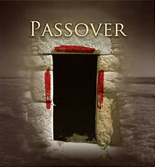
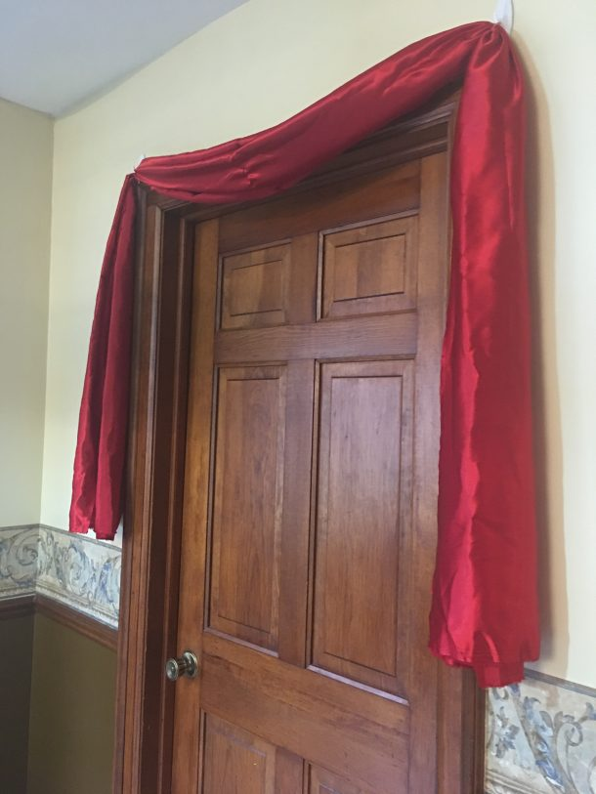
The Question Is:
Can Sunset Theory duplicate this timeline?
John 10:7 יהושע [Yahusha] therefore said to them again, “Truly, truly, I say to you, I am the door of the sheep.
John 10:9 “I am the door. Whoever enters through Me, he shall be saved, and shall go in and shall go out and find pasture.”
ה
=

Slide 24
The Hebrew letter ה.(hey) represented – Life. It was this letter that was symbolically placed on the door sills, using the blood from the sacrificed Passover Lamb.
Ex 12:8 And they shall eat the flesh on that night, roasted in fire – with unleavened bread and with bitter herbs they shall eat it.
Ex 12:7 ‘And they shall take some of the blood and put it on the two doorposts and on the lintel of the houses where they eat it.
Ex 12:6 ‘And you shall keep it until the fourteenth day of the same month. Then all the assembly of the congregation of Yisra’ĕl shall kill it between the evenings.
ה
Abib 14 Night Season/ Passover Meal | Abib 14 Light Season | Abib 15

Slide 25

The Passover Lamb was slain approximately 21 hours after the Passover meal occurred
Where did the blood for the doorsills come from?
Was that blood authentic Passover Lamb blood?
Ex 12:7 ‘And they shall take some of the blood and put it on the two doorposts and on the lintel of the houses where they eat it.
Ex 12:6 ‘And you shall keep it until the fourteenth day of the same month. Then all the assembly of the congregation of Yisra’ĕl shall kill it between the evenings.
ה
Abib 14 Night Season/ Passover Meal | Abib 14 Light Season | Abib 15

Slide 26

Where did the blood for the doorsills
come from?
Could the blood on the door sills possibly be the authentic Passover Lamb’s blood?
Ex 12:7 ‘And they shall take some of the blood and put it on the two doorposts and on the lintel of the houses where they eat it.
Ex 12:6 ‘And you shall keep it until the fourteenth day of the same month. Then all the assembly of the congregation of Yisra’ĕl shall kill it between the evenings.
The AUTHORITY died here!
ה
Abib 14 Night Season/ Passover Meal | Abib 14 Light Season | Abib 15

Slide 27
The impossibility of securing blood from the authentic Passover Lamb, a minimum of 12 hours before it was slain, leaves another valid question.
Could imposter blood used for the door sills possibly protect Yisra’el from the Executor of Death passing over at midnight?
The next slide is formatted in Sunset Theory fashion.

Slide 28
Imposter blood from a lamb (?) was placed on the door sills here.
Dawn Sunset
the evenings.
The Passover lamb was to be slain between
{Ben ha Arbayim} Ex 12:6
Abib 14 Night Season | Abib 14 Light Season
Is anyone willing to speculate how many Yisra’elites would have been protected from the Executor (who flew at midnight) had there been IMPOSTER BLOOD used?
Had the blood of a broken statute been applied to the door sills, would ANY of the Yisra’elites have survived?

Slide 29
It becomes astonishingly incredible that Sunset Theory has FAILED to fulfill and/or align with the Scriptures thus far.
This matter is rapidly becoming extremely serious!
Now that we have recognized some of the regulations for the Passover period in Mitsrayim, let’s return back to John and tune into his recordings.
Will John’s recordings align with the statutes when given a
Sunset Theory application, or will Dawn Design shine brilliantly?
We will pick up with John -
John 18:28 Then they led יהושע [Yahusha] from Qayapha to the palace, and it was early. And they themselves did not go into the palace, lest they should be defiled, but that they might eat the Passover.

Slide 30
The statutes of Yahuah have effectively removed Sunset Theory’s flag! We are now enabled to consider another option with the origin derived from the Torah!
Yahusha was standing before Pilate at Dawn of Abib 14.
Yahusha, paraded through the courts,
is presented to Pilate. Yahusha stands before Pilate as the Dawn commences.
The Last Supper with the Disciples
Abib 13 Night Season | Abib 14 Light Season | Abib 14 Night Season
Yahusha “captured” in Gethsemane

Slide 31

Yahusha is now standing before an earthly authority figure – Pilate.
Questions:
    Was Pilate well aware of the traditions of the Jews?
    Was Pilate searching for an easy way out of a serious situation with the Passover Feast rapidly approaching within minutes?
    Pilate had expressed his opinion of no guilt found in Yahusha.
    Was he expecting the rabble crowd to release Yahusha instead of Barabba?
John 18:39 “But you have a habit that I shall release someone to you at the Passover. Do you wish, then, that I release to you the Sovereign of the Yehuḏim?”
In John 19:1-12 we read of the terrible crimes done to our Saviour, Yahusha Ha Mashiach. Then we come to the time when Yahusha was before Pilate.
John 19:13 Therefore, when Pilate heard these words, he brought יהושע [Yahusha] out and sat down in the judgment seat in a place that is called Pavement, but in Heḇrew, Gabbatha.

Slide 32
Up to this point — DAWN — there has been no change in the cycle of the week from the time before the Last Supper occurred. The Last Supper event took place on Abib 13 and up until this point in time it was still Abib 13.
What extremely revealing statement did John document, at this point in time?
John 19:14 And it was the Preparation [Abib 14] Day
of the Passover week, and about the sixth hour.
And he said to the Yehuḏim, “See your Sovereign!”
Dawn – morning (boqer), had arrived. With the new light on the horizon, came the new cycle. Abib 14 had commenced with the new indirect sunlight {before sunrise}.
The 24 hour cycle of Abib 14 would continue and culminate with the burial of Yahusha just before Dawn of Abib 15 — the first Sabbath of Unleavened Bread.
DAWN

Slide 33
Passover, Abib 14 – a Preparation cycle –
Preparation for the 1st Sabbath of Unleavened Bread.
Dawn the starting point for all worship oriented hourly counting and especially for the Qodesh (Set-Apart) Sacrifice.
Dawn – 3rd Hour – Matt 20:3; Mark 15:25; Acts 2:15
Dawn – 6th Hour – Matt 20:5; 27:45; Mark 15:33; Luke 23:44; John 4:6; 19:14; Acts 10:9
Dawn – 9th Hour – Matt 20:5; 27:45,46; Mark 15:33,34; Luke 23:44; Acts 3:1; 10:3,30
Dawn – 10th Hour – John 1:39
Dawn – 11th Hour – Matt 20:6,9
Light started the cycles from the first cycle of Creation.

Slide 34
Dawn was the time of commencement; the “0” hour for the final Passover Sacrifice event. But WAIT! Did not John record the Dawn as the 6th hour in the same verse?
Excellent observation! Yes indeed John did record this same time as the 6th hour!
Was John severely delusional because of high stress? No! John was counting time according to the group which was his intended readership. They were a Gentile readership who understood when things were recorded in Roman Reckoning.
According to Roman Reckoning, which is exactly the same system the world uses today, the new 24 hour cycle switches at midnight! Let’s look at it from the Scriptures! Yahusha stood before Pilate to be sentenced. What incident occurred there as recorded by Matthew?
Matt 27:19 And as he was sitting on the judgment seat, his wife sent to him, saying, “Have none at all to do with that righteous Man, for I have suffered much today in a dream because of Him.”
When did Pilate’s wife’s cycle start? How could her “today” start at Dawn if she had dreamed, and the “today,” according to the Scriptures, had not yet arrived with the Dawn?

Slide 35
Pilate’s wife says - “TODAY.”
Midnight Midnight Dawn
Sunset
6 HRS
Matt 27:19 And as he was sitting on the judgment seat, his wife sent to him, saying, “Have none at all to do with that righteous Man, for I have suffered much today in a dream because of Him.”
Dawn
Roman Reckoning
Abib 13 ...... | Abib 14 | Abib 14..
Yahuah’s Covenant Calendar - a 24 hour Cycle
And it was the Preparation Day of the Passover week, and about the sixth hour. And he said to the Yehuḏim, “See your Sovereign!” John 19:14

Slide 36
When John recorded that at Dawn, it was the sixth hour, he was counting in the Roman style of accounting for the start of the cycle. His Gentile readership would then understand him fully.
Yet in Yahuah’s Divine Institution set from Creation, the Dawn was the starting point of the Passover cycle of Abib 14.
Matthew confirms the timing quite well as being in the – morning – Dawn!
Matt 27:1 And morning having come, all the chief priests and elders of the people
took counsel against יהושע [Yahusha], so as to put Him to death.
Matt 27:2 And having bound Him, they led Him away and delivered Him to
Pontius Pilate the governor.
We will look at a graphic next.

Slide 37
The Cycle Change from Abib 13 – to – Abib 14 morning! #1
.
Matt 26:20 And when evening came, He sat down with the twelve.
Yahusha is “captured” and paraded through man’s courts. He is eventually brought (at Dawn) before Pilate at Gabbatha
(John 19:13)
Matt 26:29 “But I say to you, I shall certainly not drink of this fruit of the vine from now on till that day when I drink it anew with you in the reign of My Father.”
Matt 26:30 And having sung a song, they went out to the Mount of Olives.
Abib 13
6 HRs - from midnight to morning (Roman Reckoning).

Slide 38
The Cycle Change from Abib 13 – to – Abib 14 morning! #2
.At
John 19:14 And it was the Preparation Day of the Passover week, and
At the point of DAWN,
about the sixth hour.
It was then, Abib 14
Reporter John announces Abib 14! It was the very beginning of the Passover.
And he said to the Yehuḏim,
“See your Sovereign!”
Abib 13 Night
REMEMBER - 6 HRs - from midnight to morning - (Roman Reckoning).

Slide 39
The Countdown to Salvation
Victory over Death! Hallelu-Yah!
Yahusha had been placed upon the tree at the third hour from dawn, as Mark records.
Mark 15:25 And it was the third hour [from Dawn], and they impaled Him.

Slide 40
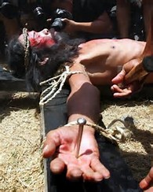
Mark’s Timing Records...
Mark 15:25 And it was the third hour, and they impaled Him.
Abib 14
3 hours - from Dawn! Mark records time from Dawn!
Abib 13 (Gethsemane)

Slide 41
The Sixth to the Ninth Hour - from Dawn!
Matt 27:45 And from the sixth hour there was darkness over all the land, until the
ninth hour.
Mark 15:33 And when the sixth hour came, darkness came over all the land
until the ninth hour.
Luke 23:44 And it was now about the sixth hour, and darkness came over all the land, until the ninth hour.
The darkest hours of this earth -
in every way.
.
Abib
14
Abib 13 (Gethsemane)
Dawn!

Slide 42
9th Hr - Volunteered Sacrifice of - Yahusha Ha Mashiach!
.
Matt 27:46, 50 And about the ninth hour יהושע [Yahusha] cried out with a loud voice, saying, “Ěli, Ěli, lemah sheḇaqtani?” that is, “My Ěl,
My Ěl, why have You forsaken Me?”
And יהושע [Yahusha] cried out again with a
loud voice, and gave up His spirit.
Luke 23:44, 46 And it was now about the
sixth hour, and darkness came over all the land, until the ninth hour.
And crying out with a loud voice, יהושע[Yahusha] said, “Father, into Your hands I commit My spirit.” And having said this,
He breathed His last.
6th Hr
3rd Hr
9thHr
Abib 13 (Gethsemane)
Dawn of Abib 14!
Please read – Mark 15:34, 37 / John 19:30.

Slide 43
What were Yahusha’s words at the last moment as recorded by John?
John 19:30 So when יהושע [Yahusha] took the sour wine He said,
“It has been accomplished!” And bowing His head, He gave up His spirit.
What was accomplished?
Yahusha accomplished; (very basically)
    A complete life on earth without sin.
    A complete “unraveling” by - Living Example, of the Torah.
    The observation of the Mo-ed Worship Feasts and Festivals before and after the crucifixion. That means – NO LUNAR TIMING!
    The TRANSFER of the Ahronic Priesthood through the last authentic Levitical High Priest – John the Baptist, to Himself the Melchi-Tzedek High Priest for ever.
    Re-establishing the Everlasting Covenant in the Melchi-Tzedek Order as given to Abraham and re-affirmed at Sinai – (Exodus 19:3-24:11).
    (The same Covenant that was broken by the golden calf event.)
    Sealing this Everlasting Covenant in the Melchi-Tzedek Order with His Blood and death at Golgotha. The Everlasting Covenant - Sealed Permanently FOREVER.
on Yahuah’s schedule,

Slide 44
We now come to an extremely crucial part of this study. It is this portion that will suggest a full paradigm shift in our belief system. This highly important portion has everything to do with the retrieval and burial of the emaciated body of Yahusha.
To say that timing is paramount to this event in terms of this investigation into the start of Yahuah’s cycles, is a severe understatement.
The event recorded next needs our full attention.
We will be focusing directly on the timing of - when - Yoseph of Ramathayim (Arimathea) asked for and retrieved the body of
The Mashiach.
This next event is directly referencing the – evening – ereb - (mixture of light and darkness).
To help our memories, we are going to look at a few Hebrew definitions for this word – ereb – evening.

Slide 45
EVENING
Because Strong’s is so common, let’s start looking at H6153 where they declare the root word to be, and that is H6150 (same spelling).
H6150 ע ר ב ereb – with 6148 through the idea of covering, with a texture; to grow dusky at sundown: be darkened (toward) evening.
H6151 ע ר ב ereb – to commingle; - mingle (self) mix,
H6153 ע ר ב ereb – from 6150 dusk: -+day, even(ing), tide), night
H6151 ע ר ב ereb – from 6148 the web (or transverse threads of cloth); also a mixture (or mongrel race) Arabia, mingled people, mixed (multitude), woof
Note the base theme of this word – MIXTURE.

Slide 46
Etymological Dictionary of the Hebrew Language: <`ereb> - ע ר ב, (some definitions apply to Light), to set (said especially of the sun), to enter, to go in, to go down, it became evening, it grew dark, sunset, evening, mixed, to mix, was mixed, was mingled, mixture, woof.
Question: What is “woof”? Let’s check the Webster’s Dictionary.
Answer: Woof: to weave, the threads that cross the warp, the weft.
A Hebrew English Lexicon by John Parkhurst (1762): Evening - ע ר ב
To mix, mingle, be mingled, a mixture, mixed multitude, rabble, of flies or insects [J Parkhurst then gives texts where flies apply] the mixers, mixed ones, light and spirit mixed together, the heavens or celestial fluid consists of this mixture, to be darkened, duskily obscured, [beyn ha arbayim] between the evenings or more literally between the mixtures, at sunset when the cool dark air mixes or night air mixes with it,
The evening air from the western or darkened part of the heavens begins to mix with
the day, which mixture continues till night, when the day is overpowered the darkness prevails and the mixture of daylight ceases. Gen i.5, xxiv.11.

Slide 47
Gesenius Lexicon (Blue Letter Bible online) ע ר ב ereb
1. according to the opinion of the Karaites and Samaritans, (which is favoured by the words of Deut 16:6) the time between sunset and deep twilight. The Pharisees, however (see
Joseph Bellum Jud.vi:9,3) and the Rabbinists, considered the time when the sun began to descend to be called the first evening (Arab – little evening, when it begins to draw
toward evening); and the second evening to be the real sunset. [Is the first not real??]
Question: AT WHAT POINT DOES “DESCENDING” BECOME A MIXTURE?? Who “FABRICATED” THIS DECEPTION -(proposing to be “god”)? Was it so that they could abide by the statute to contain the daily sacrifices within the same “day”? Would changing the daily sacrifice times to 9 and 3 allow them to retain their SERVICE TO THE MOON and FACILITATING THEIR SUNSET THEORY?
They could then say, that the “evening descent” sacrifice was done on the going down of the sun!
Shall we discard the Hebrew MIXTURE definition, and agree?

Slide 48
Gesenius Lexicon (Blue Letter Bible online) ע ר ב ereb (cont.)
2. foreigners, strangers, hence foreign kings who made alliance with the Israelites.
Note: On the #2 definition, we see once more the theme of - mixture. I find the comment made about the Pharisees and Rabbinists concept of the ereb evening beginning at noon, extremely interesting to say the least. No, not in a positive way!
When – ereb – {mixture, mixing} is applied to time as in a cycle of the week, there are only two periods within one 24 hour cycle where a mixing of light and darkness can occur. These two periods that, because of indirect sunlight, allows a mixing of light with darkness. In the morning twilight, before sunrise, the light overtakes the darkness. After the sun has set, the darkness is allowed to overtake the waning light of the sun.
Without LIGHT, there can be no mixing of light and darkness, and the opposite is true also.

Slide 49
After the sunrise and before the sunset, direct sunlight prevails and the mixing of light cannot occur. Here is an illustration for clarity sake.
Dawn Sunrise Sunset Dusk
Note the location of the MIXING of light and darkness in relation to the sunset.
Also recall that in Sunset Theory, the sunset changes the cycle of the week. With this in mind we can now progress to the words as written in the Scriptures pertaining directly to when Yoseph asked for the body of Yahusha.
No Mixture Possible!
Night
Direct Sunlight Rays
Night
Ereb – Light Mixtures!
One Morning Twilight
“Arab” (Mixture)
One Evening Twilight
“Ereb” (Mixture)
Beyn Ha Arbayim!
Between the evenings – Ex 12:6

Slide 50
Matt 27:57 And when evening came, there came a rich man from Ramathayim, named Yosĕph, who himself had also become a taught one of יהושע [Yahusha].
Note very attentively that in the Hebrew edition of Matthew, the very word – ereb – appears for “evening.” The Greek editions have the word – opsias – appearing.
Strong’s G3798 opsias – 1. late 2. evening
1. either from 3 to 6 o’clock PM
2. from 6 o’clock PM to the beginning of night
Thayers Lexicon evening – either from our three to six o’clock PM, or from our six o’clock PM to the beginning of the night.
ATTENTION: After the section where the Thayer’s Lexicon lists – “either from our three to six o’clock PM,” it also lists several texts where this word applies. Very significantly, it also lists the Matthew 27:57 verse seen above. This would indicate that Thayer’s wishes for us to accept that the evening MIXTURE is before the sunset. This is against the Hebrew definitions from the Old Testament and seen throughout.
?

Slide 51
Interestingly, for a person who is willing to do just a surface reading, these resources will by default promote the burial of the body of Yahusha before the sunset, thus promoting Sunset Theory, and ultimately a SUNday resurrection!
Can we trust these resources?
Do they reveal the Word of Yahuah - WITHOUT WAVERING?

Slide 52
Yes those questions are very serious. The questions are not just questioning the two resources listed, but is inclusive to all study tools. Be very certain that the questions are not to remove the value of the study tools, but is specifically suggesting caution combined with the importance of proving all things according to the Scriptures.
We are going to see this done, further on in this study.
The extremely important questions are:
When did Yoseph ask for the body of Yahusha?
Was it before the sunset?
Was it at the sunset?
Was it after the sunset?
The Hebrew edition of Mathew tells us Yoseph asked for the body of Yahusha when the
evening mixture had already begun to occur.
We will be carefully searching for clues to see if the Scriptures support the Greek definitions of evening occurring BEFORE the sunset.
??

Slide 53
Yoseph requests the body of Ha Mashiach – from Pilate #1
.
Abib 14 Light Season
Matt 27:57 And when EVENING came,
there came a rich man from Ramathayim, named Yosĕph, who himself had also become a taught one of יהושע [Yahusha].
Matt 27:58 He went to Pilate and asked for the body of יהושע [Yahusha]. Then Pilate commanded the body to be given.
6th Hr
3rd Hr
9th Hr
Abib 14 Night of
Embalming!
SUNSET
Are you ready too see more Scriptural proof that the sunset does not change the day?
Dawn of Abib 14!

Slide 54

Did you receive your answer?
Not yet?
Pay careful attention to the next slide and Mark’s statement of timing!
☺
Did the sunset
change the cycle?

Slide 55
Yoseph requests the body of Ha Mashiach – from Pilate #2
.
Abib 14 Light Season
Mark 15:42 And when evening had come,
because it was the Preparation Day,
6th Hr
3rd Hr
9th Hr
This documentation had just effectively DESTROYED
SUNSET THEORY!
SUNSET
Dawn of Abib 14!
Is there more?

Slide 56
Yoseph requests the body of Ha Mashiach – from Pilate #3
.
Abib 14 Light Season
Mark 15:42 And when evening had come,
because it was the Preparation Day,
6th Hr
3rd Hr
9th Hr
that is, the day before
the Sabbath,
SUNSET
Mark has DESTROYED
Sunset Theory - ONCE AGAIN!
Twice in one verse!
Dawn of Abib 14!

Slide 57
Yoseph requests the body of Ha Mashiach – from Pilate #4
.
Abib 14 Light Season
Mark 15:42 And when evening had come,
because it was the Preparation Day,
6th Hr
3rd Hr
9th Hr
that is, the day before
the Sabbath,
Mark 15:43 Yosĕph of Ramathayim, a prominent council member, who was himself waiting for the reign of Elohim, came, boldly went in to Pilate and asked for the body of יהושע [Yahusha].
SUNSET
Dawn of Abib 14!

Slide 58
More Witnesses Needed?
.
Abib 14 Light Season
Mark has just informed us that the evening mixture had arrived. Sunset by default had passed. The twilight of mixing light and darkness was occurring!
Mark then recorded quite clearly that indeed it was still the Preparation cycle of the week and yes; it was still the cycle prior to the first Sabbath of Unleavened Bread!
Not enough proof? Has this solidly proven that sunset does not change the days?
No, it is not sufficient!
We will continue our search and will most definitely recall the words of Mark!
6th Hr
3rd Hr
9th Hr
Abib 14 Night of
Embalming!
SUNSET
Dawn of Abib 14!

Slide 59
Yoseph asks for the body of Yahusha – Luke’s Account
.
Abib 14 Light Season
Luke’s account does not specify the evening when Yoseph requested the body. However, we will soon see clearly that Luke’s account is in full agreement with Matthew, Mark and John.
Luke 23:51 He was not agreeing with their counsel and deed – from Ramathayim, a city of the Yehuḏim, who himself was also waiting for the reign of Elohim,
Luke 23:52 he, going to Pilate, asked for the body of יהושע [Yahusha].
6th Hr
3rd Hr
9th Hr
Dawn of Abib 14!

Slide 60
Before the next graphic, we must examine this word – epiphosko.
This is the Greek word seen in Luke 23:54 which describes the situation during the PREPARATION and burial process of the body of Yahusha.
This word – epiphosko – has been translated as – “was approaching” and is directly referencing the 1st Sabbath of Unleavened Bread. Yes, this is extremely important.
Strong’s - epiphosko – G2020 to grow light, to dawn
Thayer’s Lexicon - epiphosko to grow light, to dawn
When this word is used, the certainty is that whatever the context is, that object is beginning to become light.
Now this statement may seem really mundane and a moot point, but it must be said:
Epiphosko DOES NOT MEAN TO GROW DARK, AS THE LIGHT SEASON DOES AFTER THE SUN HAS SET.
This point is going to become ultra important very soon.
However there is another very interesting word that needs commenting on as well.

Slide 61
Strong’s G1448 eggizo 1. to bring near, to join one thing to another
2. to draw or come near to, to approach
In the next graphic we are going to read a text that this word could have VERY EASILY been used instead of - epiphosko – (to grow light)!
Why would Yahuah allow the word epiphosko be entered into the Scriptures when the word eggizo (to draw near, to approach) could have been just as easily used?
Is Yahuah being super specific with an ISOLATING accuracy,
not allowing even one hint of a mistake whatsoever as to the precise time of the cycle He desires us to understand???
You may not understand this question just yet. Do not be disturbed, for we will address it before this study is over! ☺ But if you can, please keep this question in mind when you see the next selection from Luke.

Slide 62
Timing the Burial Process of Embalming Ha Mashiach – (Luke)
.
Abib 14 Night Season
Luke 23:53 And taking it down, he wrapped it in linen, and laid it in a tomb hewn out of the rock, where no one was yet laid.
Luke 23:54 And it was Preparation day,
Approaching = Epiphosko =
6th Hr
3rd Hr
9th Hr
Wait! Luke - what cycle of the week was this?
Abib 14 Night of
Embalming!
and the Sabbath was approaching.
SUNSET
TO GROW LIGHT!
Dawn of Abib 14!

Slide 63
Another Look at the Burial Process – (Luke)
.
Abib 14 Night Season GROWS LIGHT into the Abib 15 U/B Shabbath!
Luke 23:54 And it was Preparation day,
Approaching = Epiphosko =
Luke - what cycle of the week was this?
Abib 15 U/B
Shabbath
and the Sabbath [Dawn] was approaching.
Abib 14 Night of
Embalming!
TO GROW LIGHT!
Dawn of Abib 15!

Slide 64
Question: What if Luke had recorded in the Scriptures that it was the Preparation and it was drawing near (eggizo) to the Sabbath.
Is it possible that the time of the cycle could easily be said to be before the approaching sunset?
However Yahuah did not allow the word eggizo to be written. Instead Yahuah intended the highly accurate and specific word – epiphosko – to be recorded instead.
Luke used the word – epiphosko (to grow light). He recorded the details with EXACT timing of when (within the 24 hour cycle) the burial events took place. He made it extremely clear:
  The Preparation Day and final burial details, such as location and time, display how
  and when, the 1st Sabbath of Unleavened commenced from the Crucifixion Cycle.
  The Unleavened Bread Shabbath was approaching -
  What time of the 24 hour cycle grows light? Is it not in the morning?
Luke is telling us very clearly that as the final burial details were being accomplished, while it was still the Abib 14 Preparation cycle, the timing was very close to the morning – or DAWN!
GROWING LIGHT!

Slide 65
Is there another witness to the placing of Yahusha in the tomb on the Preparation?
John 19:42 There, then, because of the Preparation Day of the Yehuḏim, they
laid יהושע [Yahusha], because the tomb was near.
John confirms that indeed when Yahusha was laid to rest in the tomb, it was still Abib 14 and the Preparation cycle.
Let’s now consider Luke’s final witness to Abib 14 ending at Dawn, as the 1st Sabbath of Unleavened Bread is about to begin!
Luke 23:55 And the women also, which came with him from Galilee, followed after,
and beheld the sepulchre, and how his body was laid.
Luke 23:56 And they returned, and prepared spices and ointments; and
rested the sabbath day according to the commandment. KJV
These were the last minute preparations just before Dawn which is seen in the word - (epiphosko – to grow light).
The two Miryam’s, starting at Dawn, rested on the 1st Annual Sabbath of Unleavened Bread, which was on the 5th cycle of the week, also deemed a High Sabbath (John 19:31).

Slide 66
Mini Summary
We have gone on a round about journey to discover exactly
when Yoseph asked for the body of Yahusha.
We have seen two written witnesses that Yoseph asked for the body of Yahusha after the sun had set. Both witnesses declaring it was still the Preparation.
We have seen through the detailed account of Luke,
that it was not even remotely possible that Yahusha
was buried before the sun had set.
With this in mind, please consider the next slide carefully.

Slide 67
What about the Greek word – opsios – translated as – evening; written in our editions of the Scriptures?
Question #1: Is it even remotely possible that the word opsios translated as – evening – can indicate that the body of Yahusha was requested and received BEFORE the sunset?
Please think on this one for a minute.
Are we then able to trust the study tools implicitly to render truth to us from their writings? Or should we be proving all things, like the Scriptures advised
us to do, and heed Yahusha’s warnings about false scribes?
Question #2: Is it possible that the Sunset Theory has failed to
align with the Scriptures thus far?
We still have a fair bit of information to sort through yet. Will this information expose a 4th cycle crucifixion? Will it? Let’s continue investigating!

Slide 68
What was the rabble crowd of Pharisees and the imposter chief priest doing on this 1st
24 hour period of the Qodesh Convocation for the Feast of Unleavened Bread?
Matt 27:62 On the next day, which was after the preparation [Abib 15,
1st Unleavened Bread Convocation], the chief priests and Pharisees gathered together to Pilate,
Matt 27:63 saying, “Master, we remember, while He was still alive, how that deceiver said, ‘After three days I am raised.’
Matt 27:64 “Command, then, that the tomb be safeguarded until the third day, lest His taught ones come by night and steal Him away, and should say to the people, ‘He was raised from the dead.’ And the last deception shall be worse than the first.”
Matt 27:65 So Pilate said to them, “You have a watch, go, safeguard it as you know how.”
Matt 27:66 And they went and safeguarded the tomb, sealing the stone and setting the watch.

Slide 69
Matthew 27:62 has indicated quite strongly that indeed it was the 1st Sabbath of Unleavened Bread, the cycle after the Passover.
It was on this morning after the Crucifixion that the rabble group assembled to deliver their request to Pilate. {The Jewish lunar U/B Shabbat had not started yet, not until sunset would their lunar based Shabbat begin!}
What was the special request? It was for 3 cycles of Roman sentry guard at the stone door of the tomb.
Matt 27:63 saying, “Master, we remember, while He was still alive, how that
deceiver said, ‘After three days I am raised.’
Matt 27:64 “Command, then, that the tomb be safeguarded until the third day,
lest His taught ones come by night and steal Him away, and should say
to the people, ‘He was raised from the dead.’
And the last deception shall be worse than the first.”

Slide 70
What was Pilate’s response? Matthew 27:65 “…you have a watch…”
Pilate did not quibble nor reshape the time span of their request for the 3 days (Matthew 27:63) of Roman guard.
They asked to complete the 3 cycles with a Roman guard; and Pilate honoured the request.
Questions: Is it possible that these rabble leaders saw that the body of Yahusha was not taken off the tree until after the sun had set?
Is it possible that these same leaders knew how long it took to prepare the body and bury it before morning?
Is it possible that these evil men knew the statutes concerning the remains of the Passover lamb (Ex 12:10) that must be placed out of site by the morning
of Abib 15 – the Unleavened Bread Convocation?
Is it possible that these men did not understand the 3 days and 3 nights was to start from the time that Yahusha died, and not - placed in the tomb at morning?

Slide 71
Approximately 15 hours had already passed since Yahusha’s death, so the request to complete the hours of the 3rd cycle could have involved only 57 more hours. However we are only told that the next morning, the morning of the 1st Sabbath of Unleavened Bread, the Jews requested a watch citing Yahusha’s words – “After three days I am raised.”
This Roman guard would have supposedly foiled any “rescue attempt” of Yahusha’s Body during any of the night hours of Abib 14.
Matt 27:64 “Command, then, that the tomb be safeguarded until the third day, lest His taught ones come by night and steal Him away, and should say to the people, ‘He was raised from the dead.’ And the last deception shall be worse than the first.”
Had Yahusha been crucified on a 6th cycle (Friday), 24 hours would have been the longest amount of time that would have been needed to reach the 1st cycle morning (Sunday).
Pilate did however, give permission for a Roman guard based on Yahusha’s words quoted by the Jews. The 3 full cycles of Roman guard as requested was delivered.
That was from the morning of the 5th to the morning of the 1st cycle, (Thursday – Sunday).

Slide 72
POINT:
The reason to look closely at the factor of Pilate allowing a Roman Guard is that it provides another witness for the – 72 hours when Yahusha was under the influence of death’s darkness.
The difference is that the Jews of the time understood the time frame of 3 days AND
3 nights to be from 5th Cycle (Thur) to 1st Cycle (Sun) morning.

Slide 73
Now we come to some information that demands serious attention.
Mark has recorded the actions of the ladies after the first Sabbath of Unleavened Bread.
Mark 16:1 And when the Sabbath was past, Miryam from Maḡdala, and Miryam the mother of Yaʽaqoḇ, and Shelomah bought spices, to go
and anoint Him.
We have two options with this verse. 1. Apply it to the 7th Day Sabbath of the week.
2. Apply it to the 1st Sabbath of Unleavened Bread.
If we apply it to the 7th Day Sabbath, it will mean that the ladies purchased the spices as the Dawn from the Sabbath to the first cycle of the week WAS OCCURING! This presents a serious statute observance problem!
The verse in Mark says the Sabbath was past. That means the Dawn had already come to fruition. Dawn was occurring! Now let’s look at some other verses.
Luke 24:1 And on the first day of the week, at early dawn, they came to the tomb, bringing the spices which they had prepared,
The ladies were bringing spices which they had ALREADY prepared.

Slide 74
Before proceeding, the exact Sabbath must be determined (High Sabbath / weekly Sabbath):
At what point did the ladies have time to prepare the spices they had just bought?
The Scriptures tell us the Sabbath was past. That means the Dawn was in full occurrence.
The time frame for the ladies to buy the spices at approximately 5-5:30 AM in the morning and preparing the spices as they were approaching the tomb is very difficult to imagine.
Issue #2: the other option is for the ladies to find a place to purchase the spices already prepared at Dawn. Issue #3: Is Mary Magdalene included in every group of “ladies”?
Considering the former points, proceed with caution before dealing with a difficulty!
Option #2! The Sabbath that is recorded as being - PAST, in Mark 16:1 -
Mark 16:1 And when the Sabbath was past, Miryam from Maḡdala, and Miryam the mother of Yaʽaqoḇ, and Shelomah bought spices,
to go and anoint Him.
… is none other than the 1st Sabbath of Unleavened bread — on the 5th cycle of the week!

Slide 75
Buying Spices after the Sabbath was past!
.
The first Sabbath Night Season of Unleavened Bread (5th Cycle)
has been completed at Dawn of Abib 16th [Friday].
All the ladies had observed the ULB Sabbath, as recorded in Luke 23:56.
At Dawn [the 16th] the ladies had the entire 24 hours of the Preparation Cycle, before the 7th Day Sabbath began, to purchase and prepare the spices and ointments.
The Preparation 6th Cycle was the time frame when the ladies did their spice PREPARATIONS, so when they arrived at the tomb with the spices “...which they had prepared” (Luke 24:1) the spices were READY FOR IMMEDIATE USE.
Abib 16
6th Cycle -
Preparation
Abib 15 (U/B
Sabbath Night
5th Cycle
Dawn of Abib 16!

Slide 76
The transition of time in the tomb – to Ressurection Day
.
The ladies purchased spices and prepared them on Abib 16, the Preparation Cycle of the week, just prior to the 7th Day Sabbath.
72 hours from Yahusha’s death.
Abib 17
7th Day
Sabbath
Abib 16
6th Cycle -
Preparation
Abib 16 Night Season
Abib 17 Sabbath Night Season
72 hours =
3 days &
3 nights
Dawn of Abib 16, to - Dawn, Abib 17!

Slide 77
. .
Crucified!
9th
Hour
The ladies rested according to the Command.
Luke 23:56
“He gave up His Spirit. John 19:30
Abib 15 U/B Sabbath
Body out of sight before Abib 15 morning!
Ex 12:10/Luke 23:54
Abib 14
Tomb
9th
Hour
Abib 17
7th Day
Sabbath
Abib 16
6th Cycle -
Preparation
72 Hrs –
3 Days &
3 Nights
Purchase & Prepare Spices

Slide 78
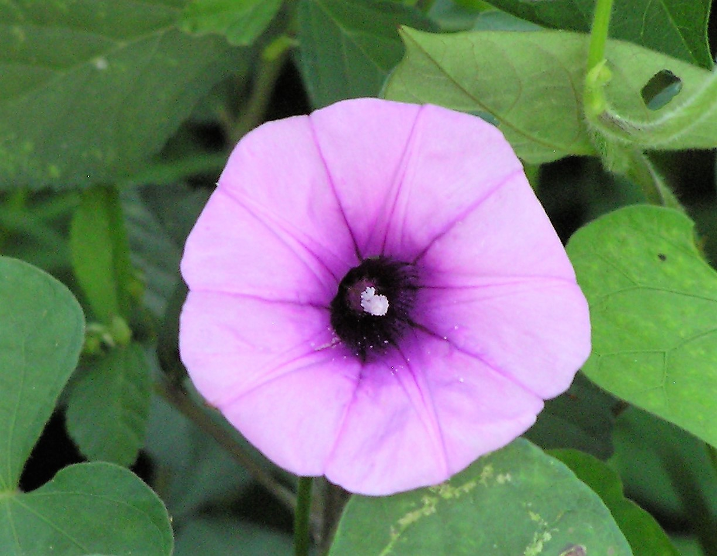
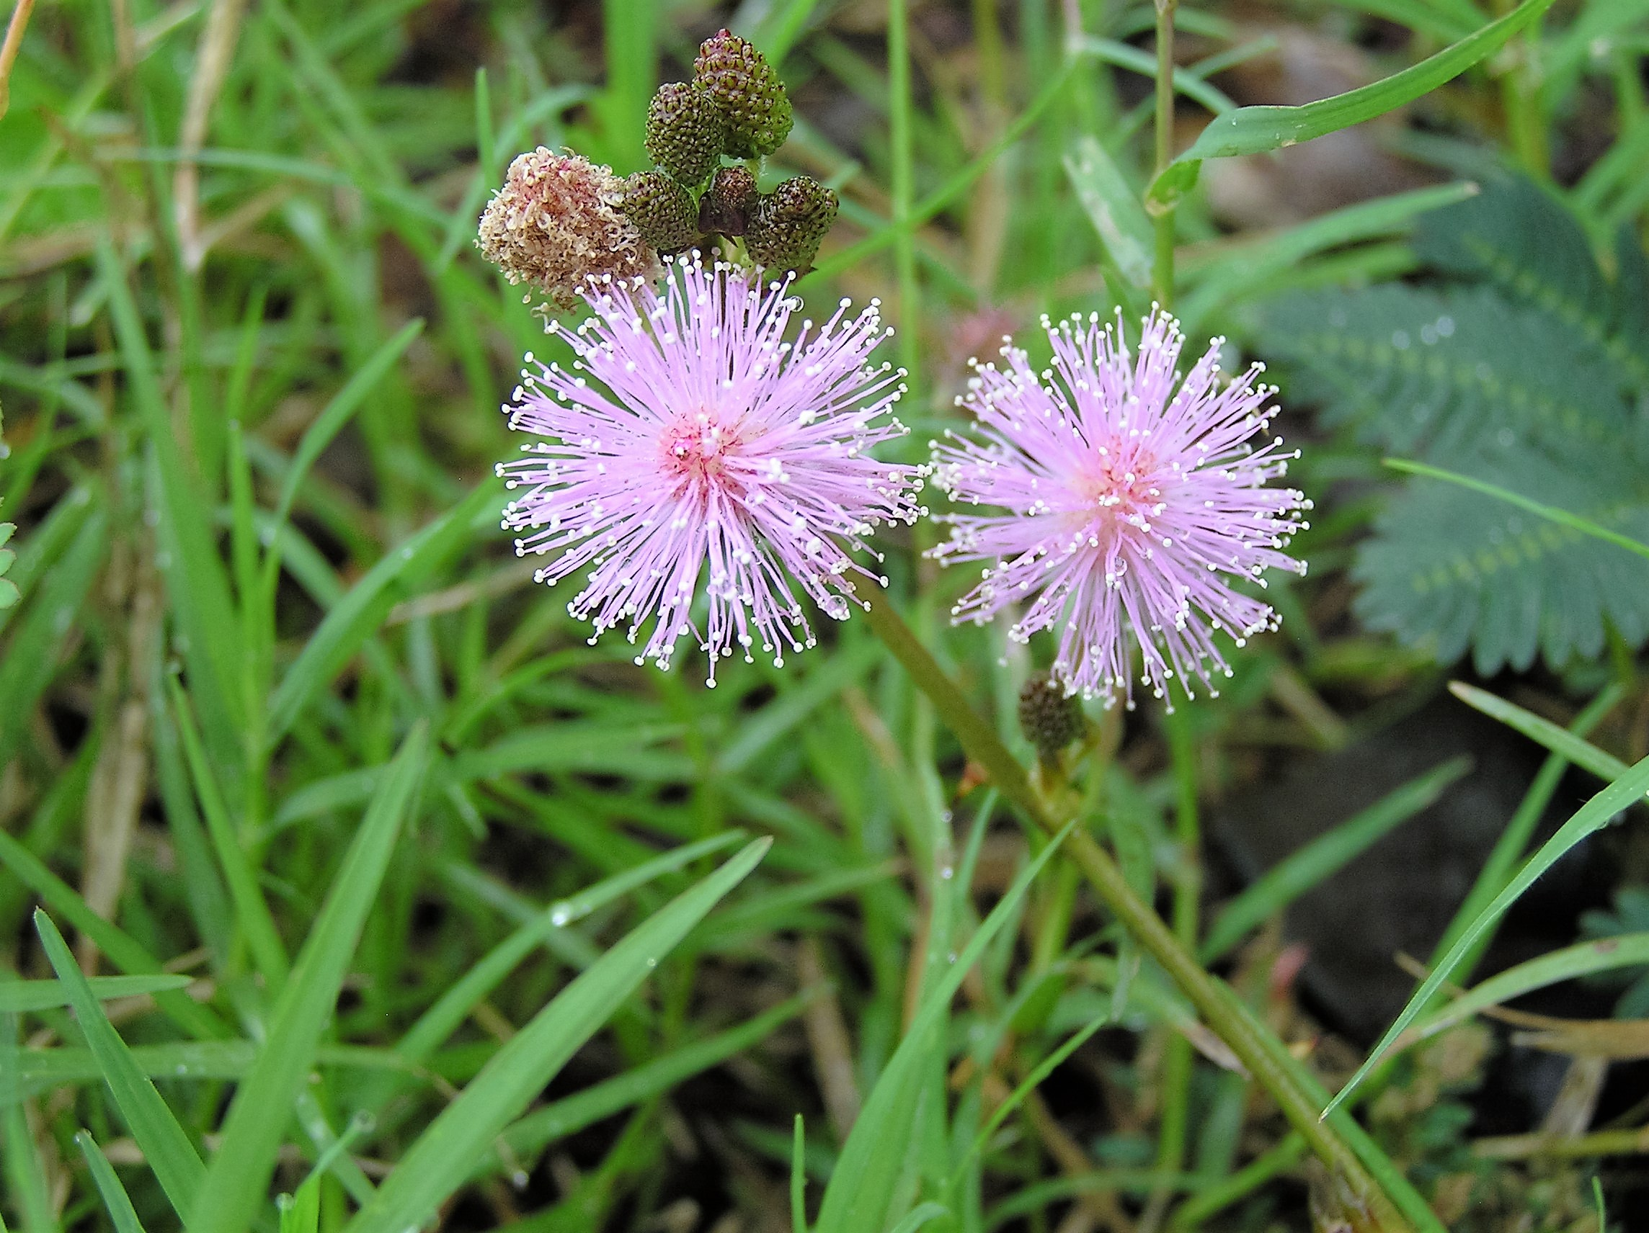
Time for a Short Break!
Next we arrive at a very interesting part of the Scriptures!
It is a tricky part in a very detailed study,
so the facts will be revealed as simply as possible.

Slide 79
Scriptures to be considered in this order!
John 20:1 And on the first day of the week [only] Miryam from Maḡdala came early to the tomb [without spices], while it was still dark,
and saw that the stone had been removed from the tomb.
Mark 16:2 And very early on the first day of the week, they [all the other women except Mary Magdalene], came to the tomb when the sun had risen.
Luke 24:1 And on the first day of the week, at early dawn, they [all the other women] came to the tomb, bringing the spices
Matt 28:1 Now after the Sabbath, toward dawn on the first day of the week, Miryam from Maḡdala and the other Miryam came to see the tomb.
which they had prepared …
The context of Matthew can only be understood
after a full and very detailed study of John & Mark.

Slide 80
Mark is quite clear; the first rays of sunlight in the Dawn were beginning to shine when the ladies [except Mary Magdalene – he talks about her in vs 9] arrived at the tomb.
Matthew is telling us that the Sabbath was ending just as the Dawn began to occur. However … Matthew is not detailed enough for the reader to gather the correct information upon his version alone. Matthew emphasizes other information missing from the other gospel accounts – he does not give details for Mary Magdalene.
Luke is also somewhat vague, but does agree with Mark (& Matthew to some extent). It was the first cycle of the week, early in the morning when ALL the ladies [except Mary Magdalene] approached the tomb at the rising of the sun.
What about John?? John has decided to put an interesting view into his writings.
John claims it was STILL DARK AND WAS THE FIRST CYCLE OF THE WEEK!
We have just been learning from the Scriptures that Yahuah’s cycles start with the Dawn. Why then does John come along and stir up the pot by saying it was still dark and it was the first cycle of the week?
Would this have anything to do with Mary Magdalene because - John does NOT mention any of the other women?

Slide 81
The information we have is that John was living in Antioch, a Roman city, at the time of this writing. John was writing to a fully Gentile readership. He wanted them to know the exact proper timing of the true Messiah on the Roman method of keeping time. His full intent was to get the gospel message to the Romans, Greeks and the rest of the gentile world, unto the ends of the earth. Back then in their society, exactly the same as we have today, the start of the cycles of the week was deemed to commence at midnight.
Remember: John claims it was STILL DARK AND WAS THE FIRST CYCLE OF THE WEEK!
John 20:1 And on the first day of the week Miryam from Maḡdala came
early to the tomb, while it was still dark,
and saw that the stone had been removed from the tomb.
With a careful examination of the four gospel writers, John is the only one that gives ultimate detail on only Miryam from Magdala. He doesn’t even mention the other women. Why? Because he was an “eye witness” to what was happening with Miryam from Magdala. When she had arrived at the tomb very late on the Sabbath hours, it was still dark. She did not come with spices, but seeking her Master.

Slide 82
.
John 20:1 And on the first day of the week Miryam from Maḡdala came early to the tomb, while it was still dark, and saw that the stone had been removed
from the tomb.
Mary was there alone.
At this point she reported to Peter and John what she had found – nothing! It appears their Master is missing – perhaps stolen!
Abib 18
1st Cycle
Abib 17
Sabbath Night!
Midnight to Dawn is 6 hours!
John 20:1, writing of the first cycle of the week, in Roman Reckoning, starts here.

Slide 83
What Happens Next?
In this pitch darkness, Peter and John follow Mary to the tomb to see if what she has reported to them is indeed true. Yes it is true.
They find NOTHING, and promptly return to their homes.
For some reason they were not with the other disciples.
They believe Yahusha is missing, but do not believe He is risen, according to John’s personal experience and account (20:9).
Mary lingers around the dark tomb while twilight nears.
This is when she is blessed to see two angels in the tomb.
They do not tell her Yahusha has risen.
Next a voice calls to her – she thinks it is the gardener, but it is Yahusha Who tells her He must quickly ascend to His Father.
Remember, twilight is drawing near as He leaves!

Slide 84
The synoptic gospels do not give specific details about Miryam from Magdala – only Reporter John has the information that changes everything.
Details After Resurrection: John’s Facts: “when it is still dark”
John is the only writer to give any detail of Miryam from Magdala – all during the final hours of the 7th day Sabbath. However in Roman time, the new day began at midnight. Thus John notes the “weekday” was already the 1st day of the week. These details were missing in the other gospels. John does not mention the “other women” because those details were well covered in the synoptic gospels. However, after the account of Miryam M John skips directly to Yahusha’s appearance with the disciples saying, “Then the same day at evening, being the first day of the week, when the doors were shut …” (20:19). With intense detail, the new day did NOT begin at evening on the 1st day of the week.
Details After Resurrection: Synoptic Facts: “when the dawn begins”
Matthew, Mark and Luke give details about all the “other women” only when the new day arrived with light on the 1st day of the week. Mark specifically says: “at the rising of the sun” (16:2) so there is no mistake. There are many “Marys” involved in this account. All 3 writers mention Miryam from Magdala distinctly – however vaguely. These “other women” all arrived at the tomb (after Mary [M]) was there - during twilight and sunrise with prepared spices. Miryam from Magdala did not have any spices. The “other women” also encountered the angels, and Yahusha, only after He had visited Mary M and returned from His heavenly mission. Through John, we see Mary Magdalene was favored above all.

Slide 85
Yes, according to Roman Reckoning, for a Gentile readership, it was indeed the 1st cycle of the week while it was still dark.
John was not writing out of synch with his intended audience.
This knowledge brings Matthew, Mark, Luke (including the two Miryam’s) and John into full agreement and complete Scriptural alignment.
There is no discrepancy now.
Before we move on, there is a serious matter that needs to be addressed. Matthew 28:1 will be once again quoted, but from the HalleluYah Scriptures edition this time.
Matt 28:1 Now after the Shabbath, toward dawn on one of the shabbathoth, Miryam from Maḡdala and the other Miryam came to see the tomb.
An erroneous claim has been produced to claim the original word – shabbathoth – MUST ALWAYS be referencing a Sabbath cycle. This is a false and misleading claim. For more information that will give full clarity by six witness texts from your Scriptures, please ask for the study named Sabbath or Sunday – The First Day of the Week.

Slide 86
Moving forward -
Question: What unique incident transpired at the tomb, at the Dawn of the 1st cycle of the week?
We know full well that the tomb was already empty well before Dawn as Miryam from Magdala was there while it was still dark. But there is something else that is very fascinating. An interesting little incident took place that gives a massive hint that Yahusha was OBSERVING THE FEASTS AND FESTIVALS EVEN AFTER THE TREE!
Yes, Yahusha was leading by example! (1 Peter 2:21) This is one of His examples.
We will be reading from – The HalleluYah Scriptures once again for it gives the meaning closest to the original words. (Peter and John have left … but Mary lingers in wonderment!)
John 20:11 But Miryam was standing outside by the tomb weeping.
Then as she wept, she stooped down to the tomb,
John 20:12 and saw two messengers in white sitting, one at the head and the other at the feet, where the body of יהושע [Yahusha] had been laid.

Slide 87
John 20:13 And they [two messengers in white] said to her, “Woman, why do you weep?” She said to them, “Because they took away Adonai, and I do not know where they laid Him.”
John 20:14 And having said this, she turned around and saw יהושע [Yahusha] standing, but she did not know that it was יהושע [Yahusha].
John 20:15 יהושע [Yahusha] said to her, “Woman, why do you weep? Whom do you seek?” Thinking He was the gardener, she said to Him, “Adonai, if You have carried Him away, say to me where You put Him, and I shall take Him away.”
John 20:16 יהושע [Yahusha] said to her, “Miryam!” She turned and said to Him, “Rabboni!” which translated is, Teacher.
John 20:17 יהושע [Yahusha] said to her, “Do not hold on to Me, for I have not yet ascended to My Father. But go to My brothers and say to them,
‘I am ascending to My Father and your Father, and to My Elohim and your Elohim.’ ”

Slide 88
Where did Yahusha assert He was traveling to?
“I am ascending to My Father and your Father,
and to My Elohim and your Elohim.”
Yahusha was ascending to our Father Yahuah. But WHY is the question!
What cycle of the week was it presently?
The DAWN brought forth Yahuah’s 1st cycle of the week and most importantly,
the 1st cycle of the week AFTER THE FIRST 7TH DAY SABBATH
WITHIN THE FEAST OF UNLEAVENED BREAD!
Saying this is important, is a massive understatement!
HUGE!

Slide 89
For a few thousand years the Feast of the Harvest (Wave Sheaf) had been prophesying of this most specific event!
Yahusha being the Antitype (the first portion of the harvest) needed to ascend to Yahuah the Father to present the first portion of the Harvest for acceptance. That first portion of the Harvest was Yahusha Himself as the Ultimate Sacrifice; and, having triumphed over death, Yahusha was the actual “first fruit” harvested from the grasp of death. Yahusha needed to present Himself before Yahuah in the Heavenly court for inspection and judgment to see if His Sacrifice would be accepted or not.
It was at this time (the 1st cycle of the week after the 7th Day Sabbath) that the Wave Sheaf offering had been presented for thousands of years. It was on this same cycle that Yahusha ascended to Heaven to present Himself to the Father as -
THE FIRSTFRUIT! The Eh’Tzem (Bone structure)!
Yahusha asked Miryam to not hold onto Him as He did not want to be delayed at all.
Yahusha carried through with His intentions to fulfill the observance of the Feast of Harvest (Wave Sheaf), after His death — after the tree. Yahusha left us the example
of observing the Feasts forever. When? - just hours after His resurrection.
Notes:
I know that some are not aware of this profound example. I feel it is extremely important.

Slide 90
Yahusha informs Mary of His Travel Intentions
John 20:17 יהושע said to her, “Do not hold on to Me, for I have not yet ascended to My Father. But go to My brothers and say to them, ‘I am ascending to My Father and your Father, and to My Elohim and your Elohim.’ ”
1st Cycle of the week, after the 7th Day Sabbath
Abib 18
1st Cycle
Lev 23:15 ‘And from the morrow after the Sabbath, from the day that you brought the sheaf of the wave offering, you shall count for yourselves: seven completed Sabbaths.’
Abib 17
Sabbath Night!
Yahusha, the Antitype of the Wave Sheaf, was observing this same Feast, AFTER HIS RESURRECTION. He was to present Himself in the Courts of Heaven for acceptance of His Ultimate Sacrifice!

Slide 91
Yahusha returned to this earth on the same 1st cycle that He ascended to present Himself as the First Fruits of the Harvest. At His return, Luke records Yahusha being with the two men near the evening twilight as they begin to eat.
Luke 24:29 But they urged Him strongly, saying, “Stay with us, for it is toward evening, and the day has declined.” And He went in to stay with them.
When Yahusha broke the bread, they recognized Him and Yahusha immediately disappeared.
Yahusha then reappears in the evening twilight season to the group gathered in Yerushalayim (Jerusalem). Notice how specific John is with his record.
John 20:19 When therefore it was evening on that day, the first day of the week, and when the doors were shut where the taught ones met, for fear of the Yehuḏim [Jews], יהושע [Yahusha] came and stood in the midst, and said to them, “Peace to you.”
Question: If the sunset had changed the cycle of the week, how could it still be the first cycle of the week? John tells us the evening timing on that cycle and declares it to be the 1st cycle of the week - {STILL}!
WHAT HAPPENED TO THE SUNSET THEORY HERE???

Slide 92
HOW MANY TIMES CAN SUNSET THEORY FAIL BEFORE IT IS CONSIDERED FALSE???
5x, 4x, 3x, 2x, or even ONCE? How often can an institution of Yahuah fail??? ONCE??

Slide 93
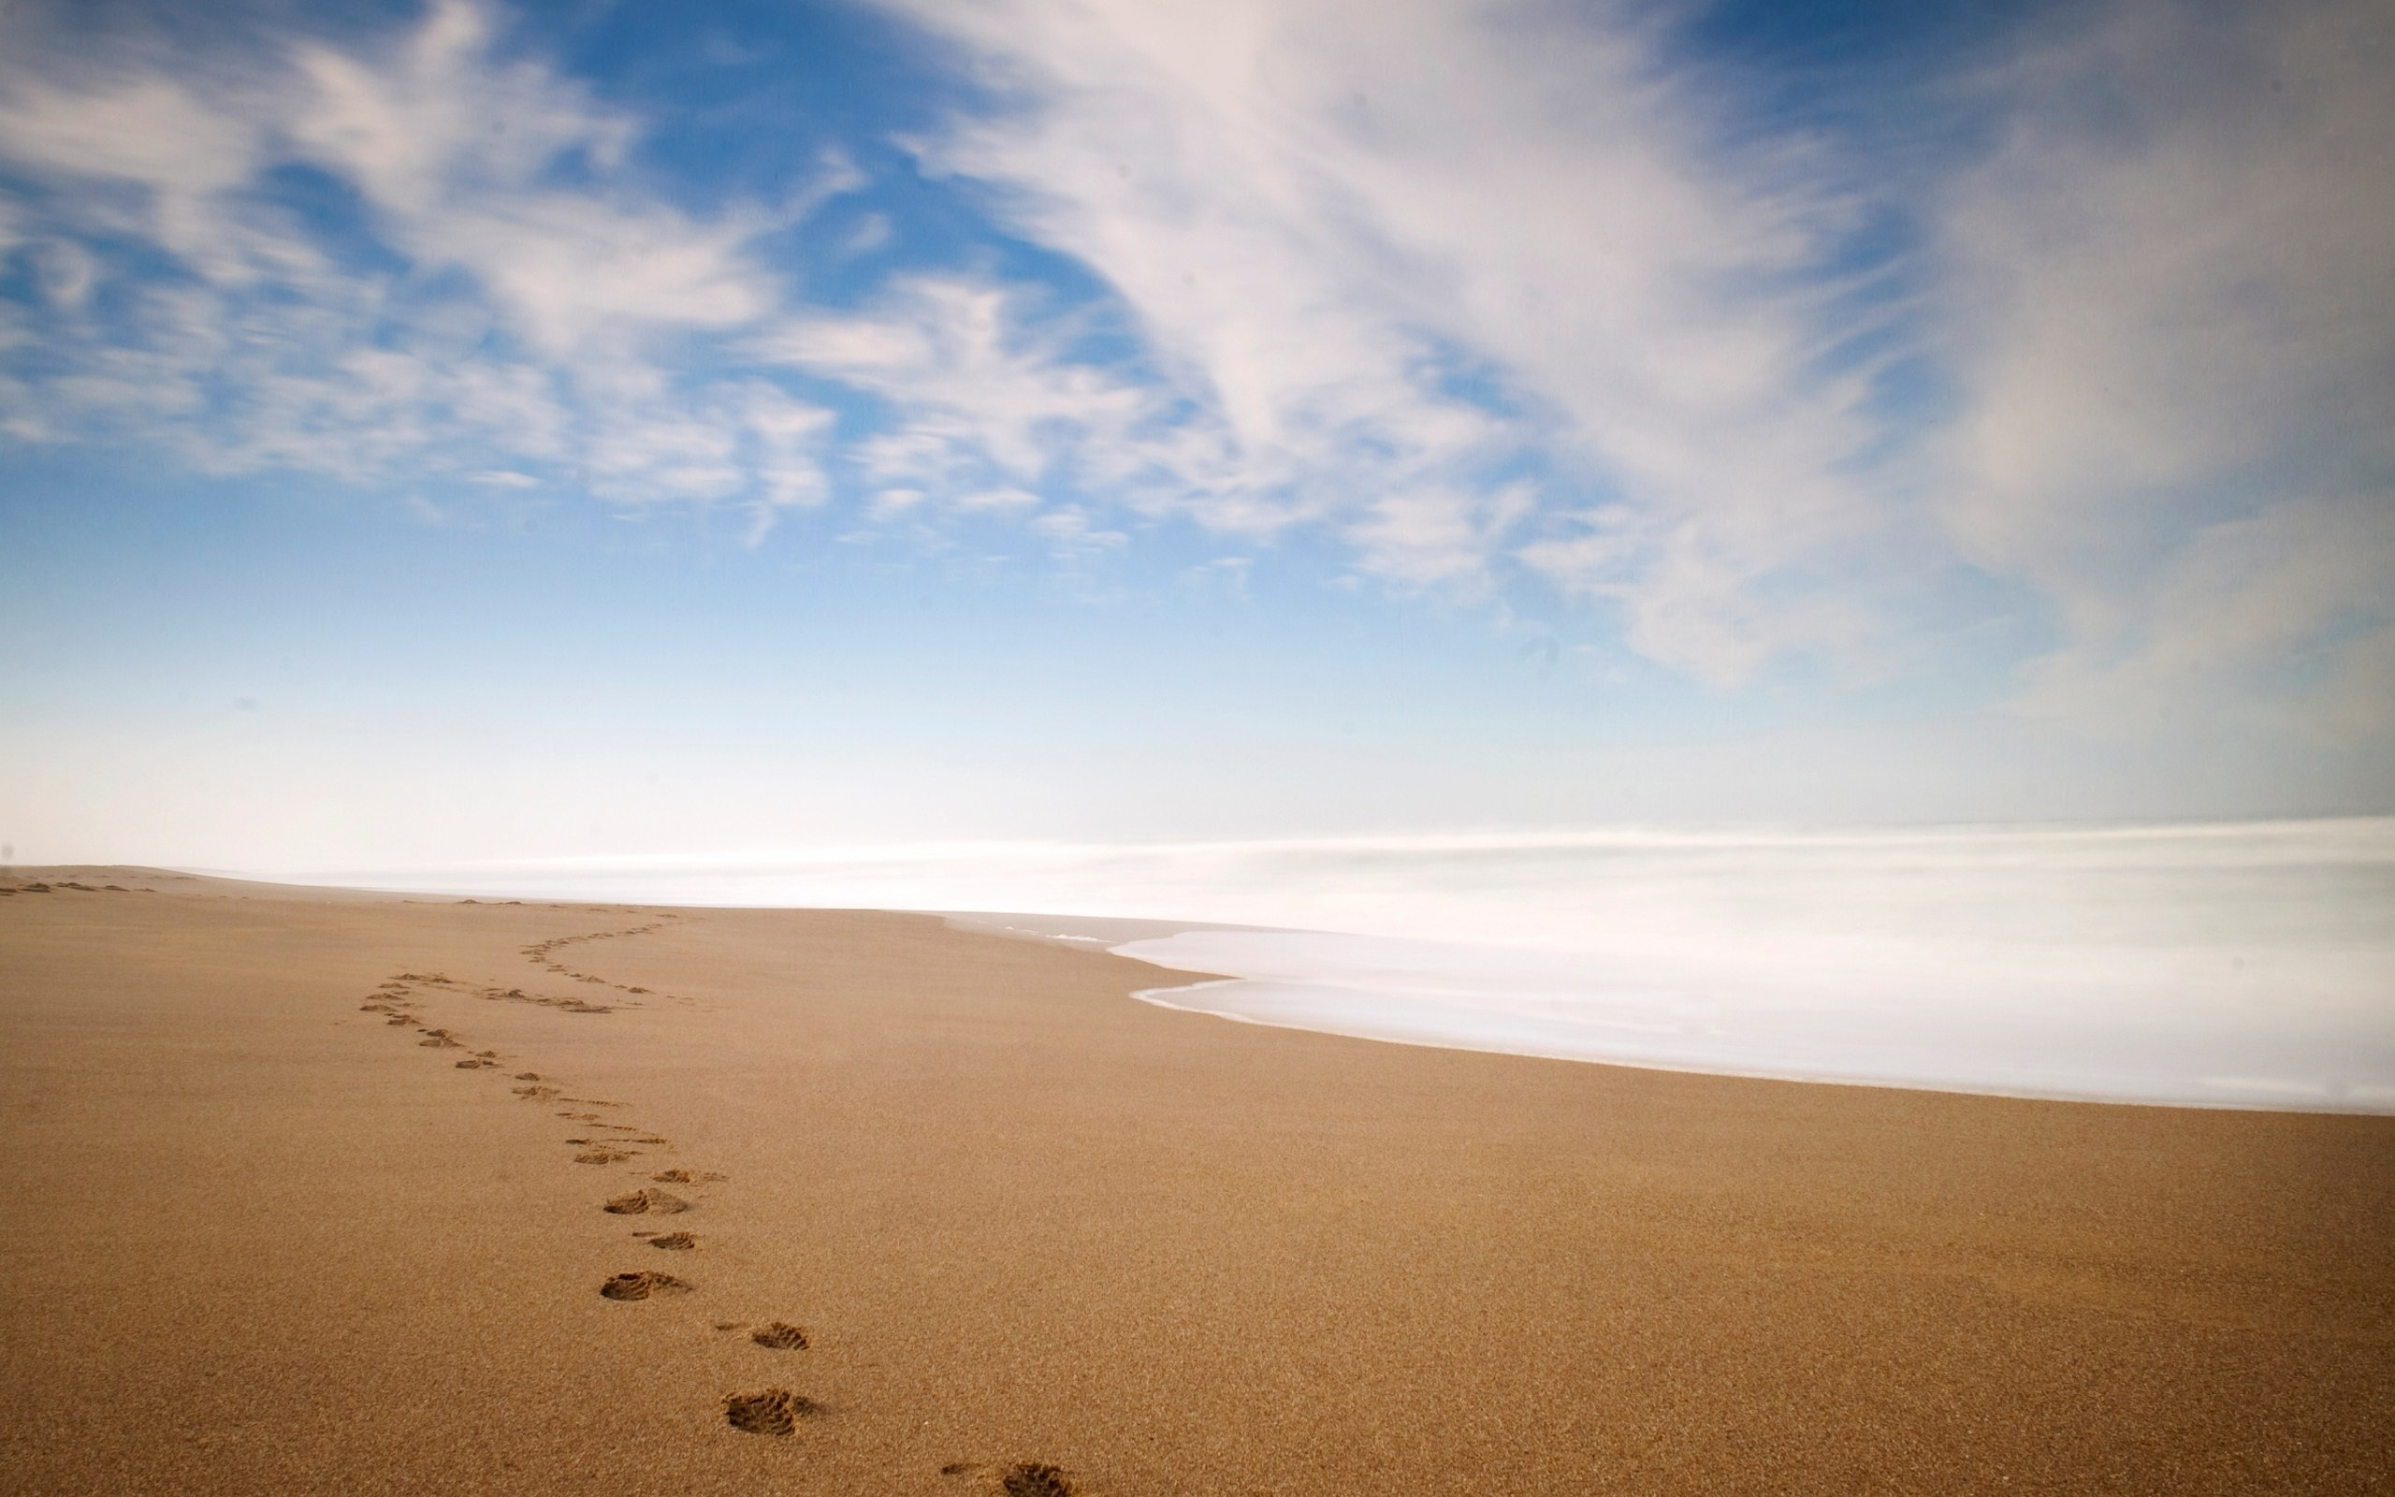
We are at the end of this study.
I truly hope you will give what we have learned here, some very serious thought.
The Hebrew word – shema – basic definition comes to mind; Listen and act accordingly.
The End

Slide 94
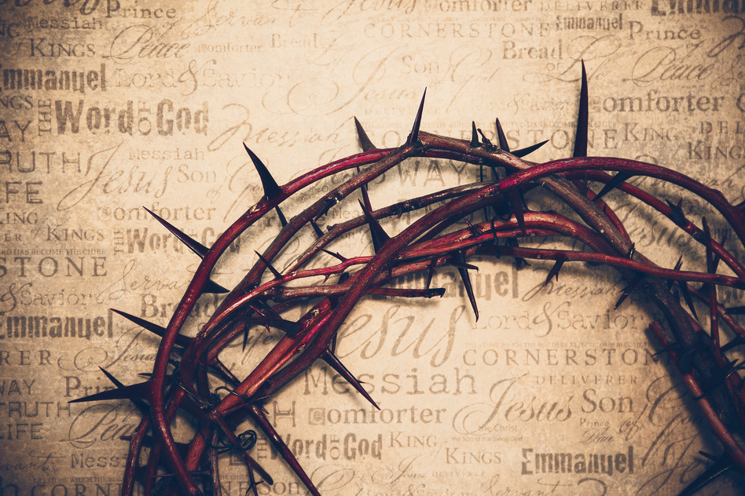

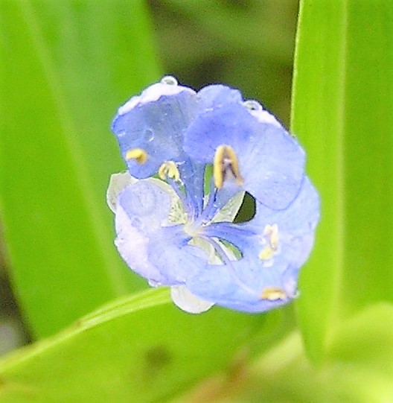
Yahusha ha Mashiach sealed His Covenant Calendar with His death & resurrection.
If more help is needed
please send your questions
& comments to:
questions@studythecalendar.com
Website:
studythecalendar.com

Slide 95
A flower from
Nicaragua that
is about the
size of your
baby fingernail!
It is one of
Tim’s favorites!
Let’s be sure to
appreciate
Yahuah’s beauties.

